Slide 1
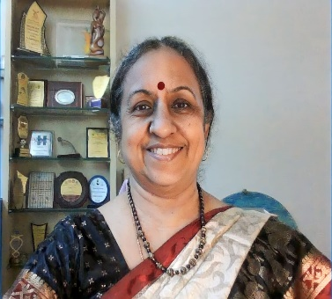
Vasumathi Sriganesh – BSc, MLIS
Former Medical librarian - Hinduja Hospital & HELP, Mumbai Founder & CEO – QMed Knowledge Foundation, Mumbai
Teaching:
620+ lectures / webinars (including some keynotes) and
270+ workshops on literature searching and referencing
Creator:
Elearning courses:
Literature searching
Reference Management
Basics to Advanced
Recognitions:
Maharashtra University of Health Sciences – Speaker
Maharashtra Medical Council – Speaker
MMC – Accreditation for QMed – for webinars
Academy of Health Professions Educators – Member
Expertise:
Systematic Reviews : Searching, Removing Duplicates
Reference Management
Assists & Coaches SR author in these areas
Awards:
International Medical Librarians Conference – 2013
Pfizer – Education Grant – 2023
Dr SR Ranganathan Lifetime Achievement Award - 2024

